Slide 1
Modifications to java.util
Not so many changes

Slide 2

Presentation Topics
In this presentation we will cover:
What’s changed
Working with formatted data
© DevelopIntelligence http://www.DevelopIntelligence.com

Slide 3
Objectives
When you are done, you should be able to:
Identify what changed in the java.util package
Describe how to generate formatted output
© DevelopIntelligence http://www.DevelopIntelligence.com

Slide 4
Overview of java.util
Package containing:
  Collections Framework
  Event models
  Date and Time facilities
  Internationalization
  Miscellaneous classes
© DevelopIntelligence http://www.DevelopIntelligence.com

Slide 5
What’s changed?
Not much introduced outside of Collections Framework
  New methods added to existing classes
  Few new classes
    Formatter
    Scanner
    UUID
© DevelopIntelligence http://www.DevelopIntelligence.com

Slide 6
Formatter
Provides C-like formatted output
Can use for layout justification and alignment
Supports locale centric formatted output:
  Numbers
  Strings
  Date / time
Multiple ways to format
  Formatter instance
  String.format
  System.printf
© DevelopIntelligence http://www.DevelopIntelligence.com

Slide 7
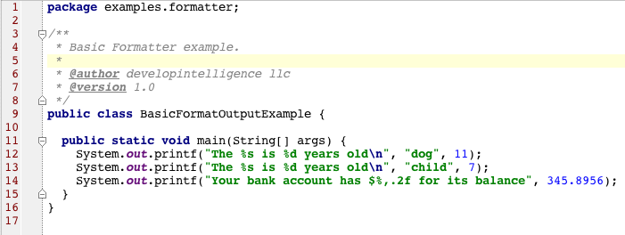
Formatter Example
© DevelopIntelligence http://www.DevelopIntelligence.com

Slide 8
Formatted Input
Provides simple text-input Scanner
Can parse primitives and strings
Supports regular expressions
© DevelopIntelligence http://www.DevelopIntelligence.com

Slide 9
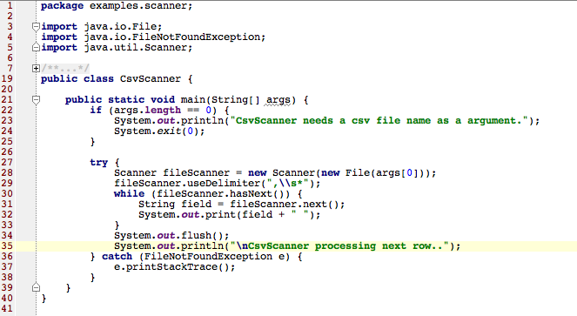
Scanner Example
© DevelopIntelligence http://www.DevelopIntelligence.com

Slide 10
UUID
Class for creating immutable Universally Unique Identifiers
Represented as 128-bit number
© DevelopIntelligence http://www.DevelopIntelligence.com

Slide 11
Summary
Formatter used for formatted String generation
Scanner used to parse text into typed representations
© DevelopIntelligence http://www.DevelopIntelligence.com

